Slide 1
SECURE DATA HIDING IN IMAGE USING STEGANOGRAPHY
PRESENTED BY : DHANANJAY SINGH.
COLLAGE NAME : KASHI INSTITUTION OF MANAGENT AND SCIENCE.

Slide 2
Content of Project
Problem Statement
Technology used
Wow Factors
End User
Results
Conclusion
Github Link
Future Scope

Slide 3
A SIMPLE STEGNO GRAPHY PROGRAME
First step of Programe
Write a code in Python for Stegnography in which The programe will accept a image and a secret message and a password for encryption
Second step
Now a new encrypted image will be created name as ecryptedimage.jpg
Third Step
Now the encrypted image will accept same password which was used during encryption and extraxt the Information which was bullted in image

Slide 4
TECHNOLOGY USED
In this project I am using python to write my code for stegnography for the project
Cv2 which opencv-python 4.11.0.86 Python Library used in this code
Which can be installed using terminal code – pip install opencv-python link
Import cv2
Use of operating system by using syntax –
Import os
Use of string :
Import String

Slide 5
AMAZING FACTS ABOUT THIS PROJECT
Hiding Data in Images with LSB (Least Significant Bit)
Fact: Python is widely used to implement the LSB technique, where data is hidden in the least significant bits of an image's pixel values.
Why It's Wow: This method is simple yet powerful, allowing users to hide text, files, or even other images within a carrier image without visibly altering it.
Steganography for Cybersecurity
Fact: Python-based steganography tools are used in penetration testing and ethical hacking to demonstrate how data can be exfiltrated covertly.
Why It's Wow: These tools help cybersecurity professionals understand and mitigate risks associated with steganography.

Slide 6
END USERS
Steganography is a powerful tool for secure and covert communication, allowing users to hide sensitive information within everyday files like images, audio, or videos. This project is designed for individuals and organizations looking to protect their data from unauthorized access while maintaining the appearance of normal files. Whether you're a journalist safeguarding confidential sources, a business securing proprietary information, or simply someone who values privacy, this steganography solution ensures your data remains hidden and accessible only to those with the right key. With an intuitive interface and robust encryption, this project empowers users to communicate securely without drawing attention, making it an essential tool for modern digital privacy

Slide 7
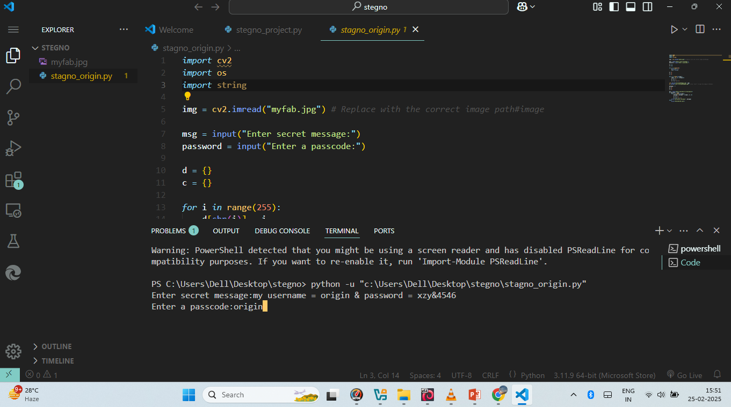
RESULT 1

Slide 8
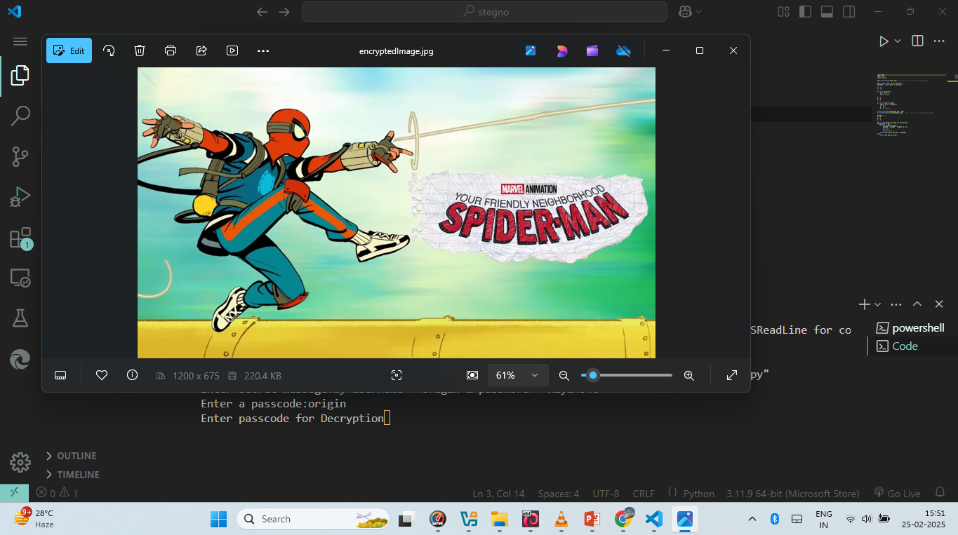
RESULT 2

Slide 9
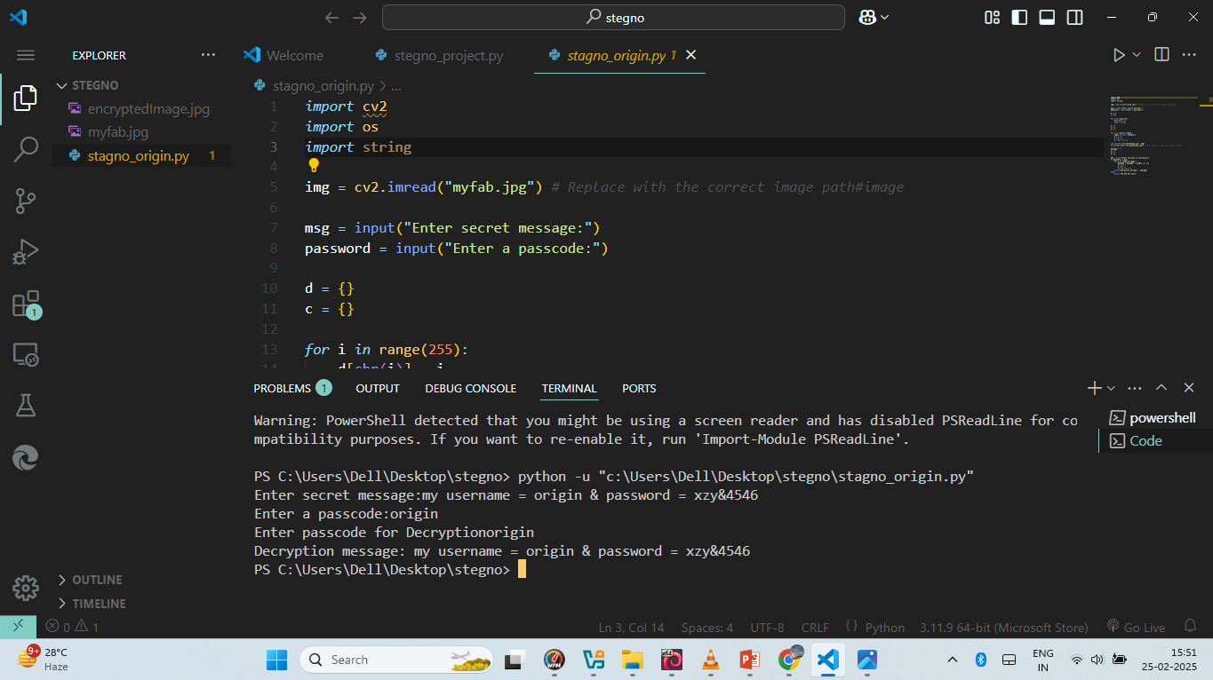
RESULT 3

Slide 10
CONCLUSION
In conclusion, this steganography project demonstrates the power of combining technology and creativity to achieve secure and covert communication. By leveraging techniques like LSB (Least Significant Bit) and encryption, we have created a robust system that allows users to hide sensitive information within everyday files such as images, audio, and videos. This project not only highlights the importance of data privacy and security in the digital age but also provides an accessible and user-friendly solution for individuals and organizations alike. As cyber threats continue to evolve, tools like this will play a crucial role in safeguarding information and ensuring secure communication. Moving forward, we aim to enhance the project with advanced features, such as AI-based steganography and support for additional file formats, to further empower users in protecting their digital assets

Slide 11
GITHUB LINK
GO TO THE PROJECT

Slide 12
THANKYOU

